Slide 1
Molecular Medicine and Gene Therapy

Slide 2
Monogenetic Disorders
Single gene pathway
Multi gene pathway: But one gene only mutated
Multifactorial Disorder or polygenic disorder

Slide 3
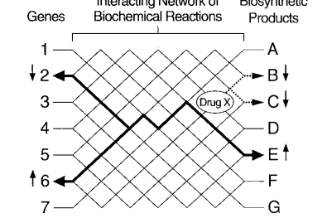
Gene Therapy and pattern of expression
“ Fully achieving this goal requires requires insight not only into the ways gene interact with each other, but also the way genes interact with the environment. “
An introduction to molecular medicine and gene therapy, copyright 2001

Slide 4
Hypercholesterolaemia and its Potential Role in the Presentation and Exacerbation of Hypertension
Hypertension: a major cardiovascular risk factor and its unclear reason of pathogenesis.
Hypertension and dyslipidaemia: independent but synergistic cardiovascular risk factors
Hypercholesterolaemia: promotes impairment in several mechanisms,
Implicated in blood pressure control such as nitric oxide bioavailability,
Renin-angiotensin activity,
The sympathetic nervous system,
Sodium and fluid homeostasis and,
Ion transport/signal transduction

Slide 5
Hypercholesterolaemia and Blood pressure
(Full article: http://www.medscape.com/viewarticle/490536)

Slide 6
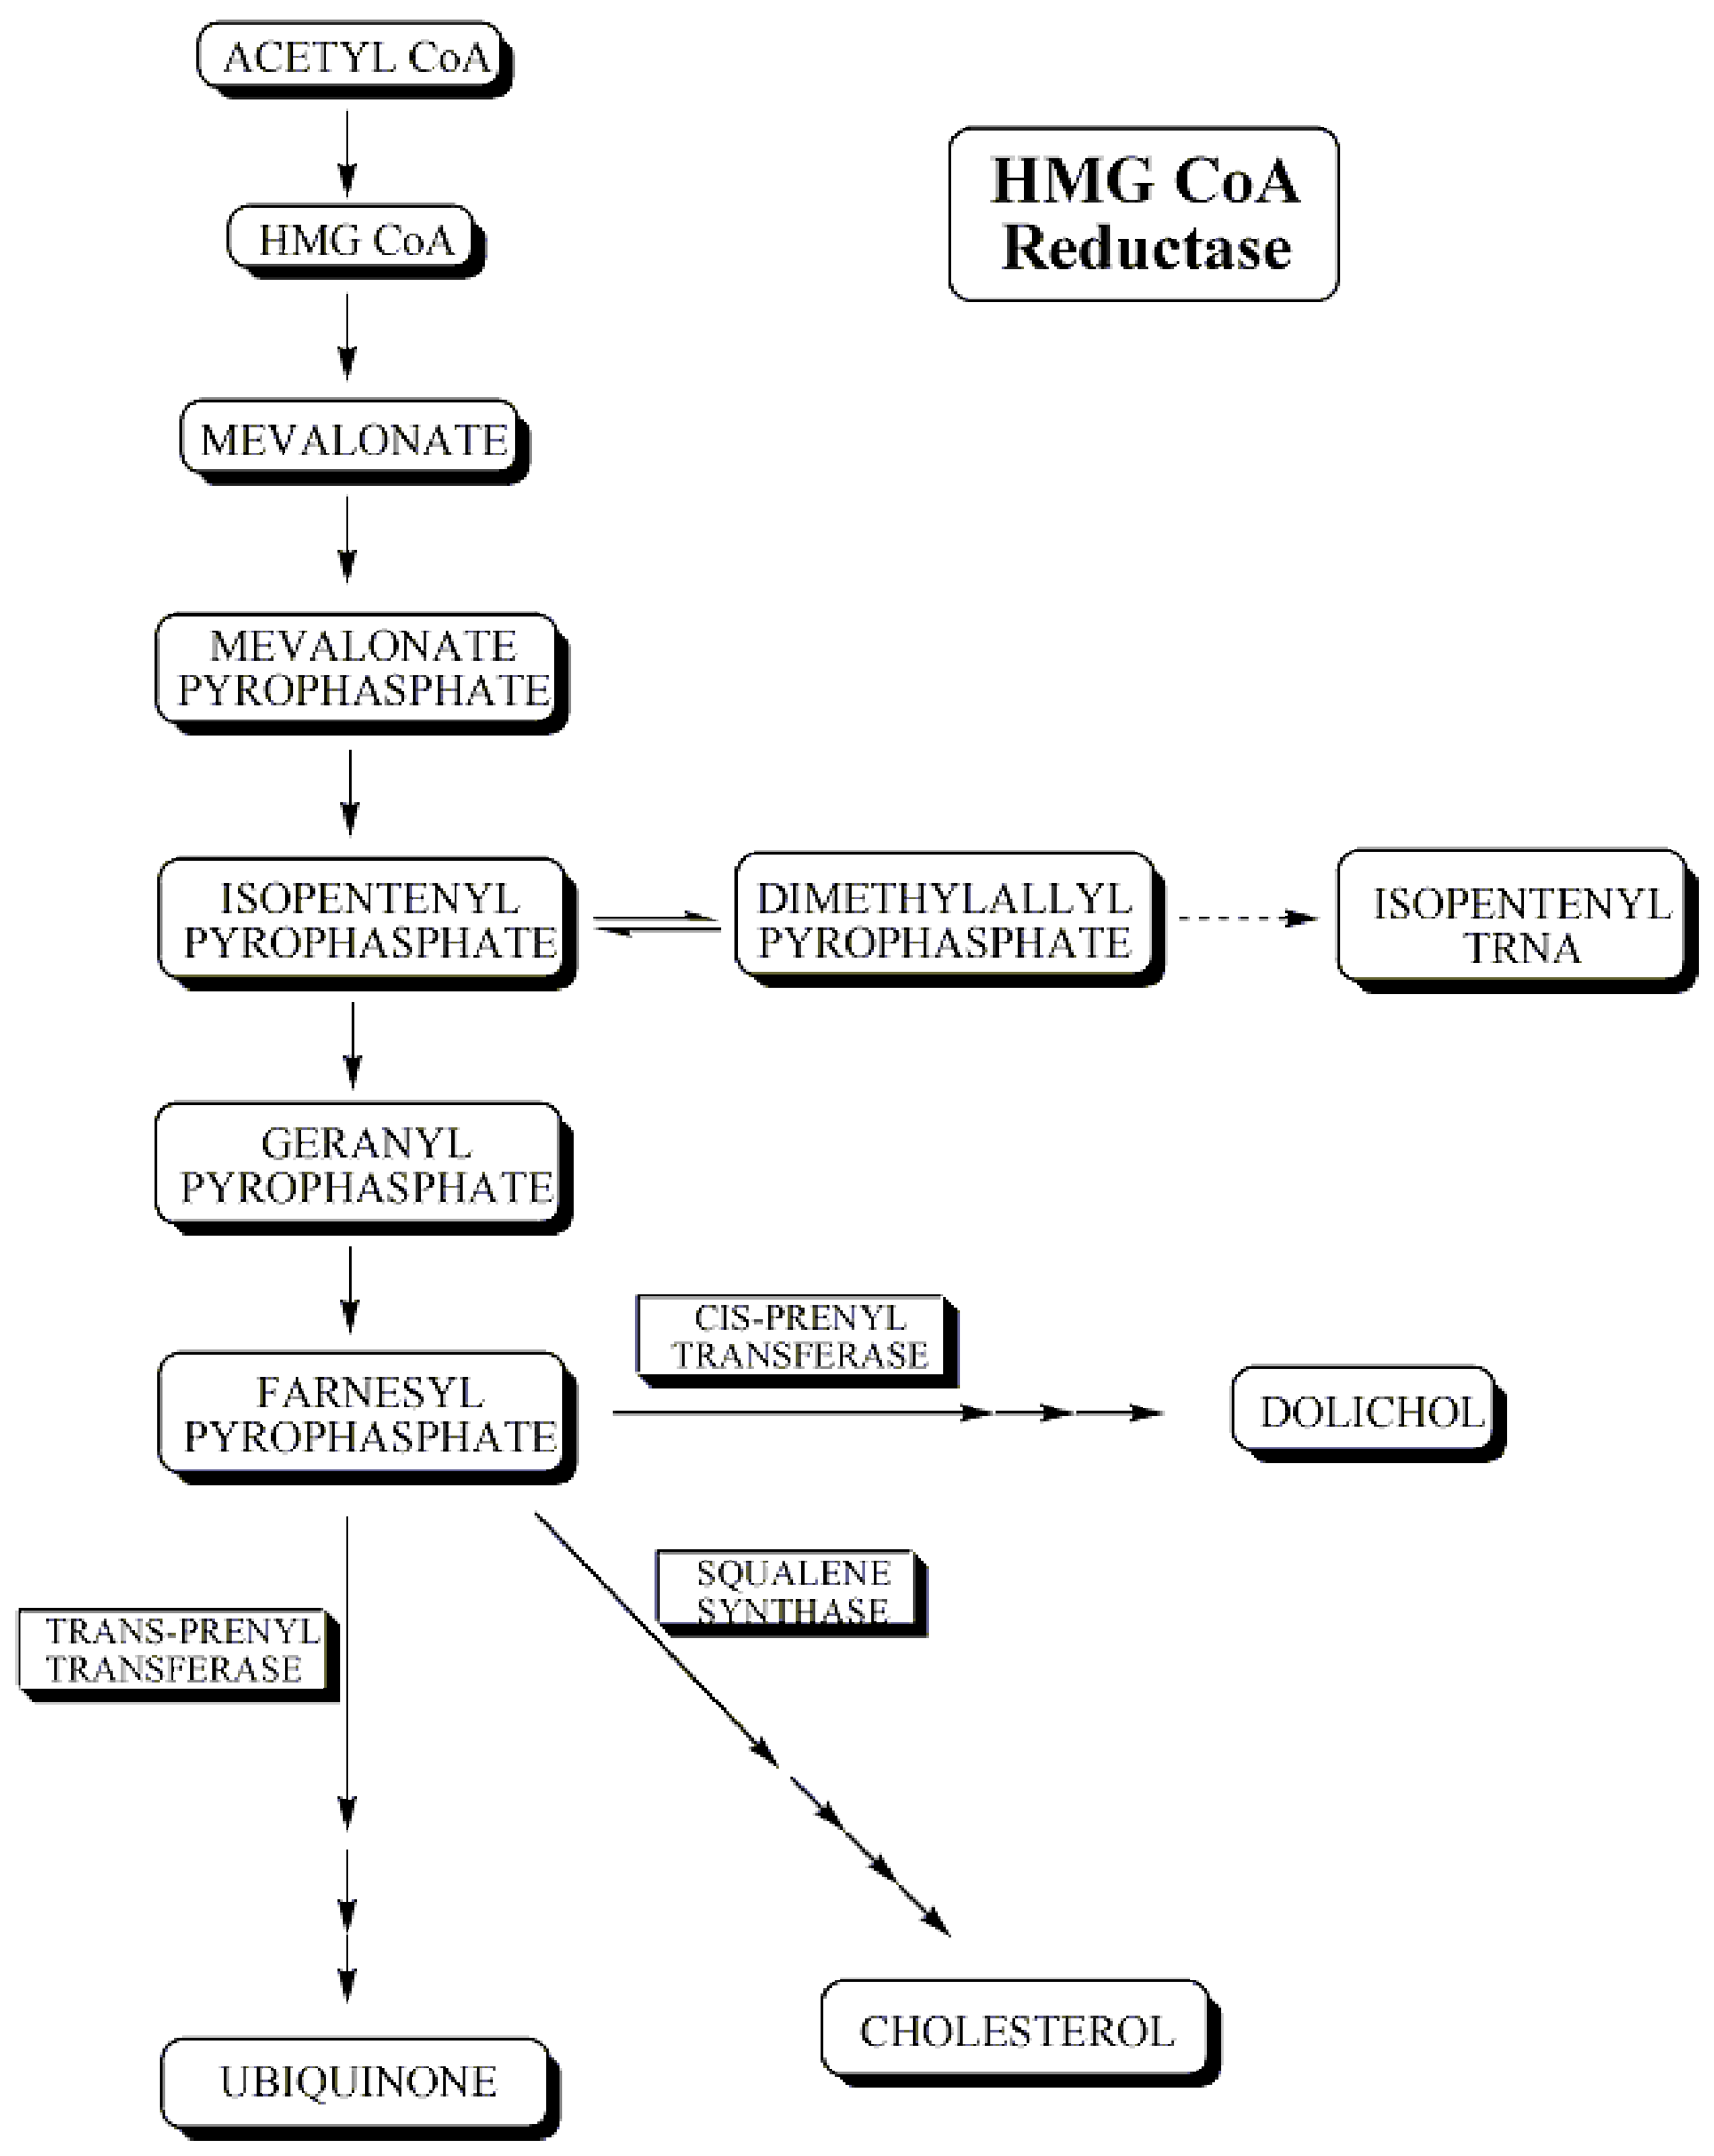
Cholesterol synthesis and inhibition
HMG-CoA
Lovastatin
http://reference.findtarget.com/search/Lovastatin/

Slide 7
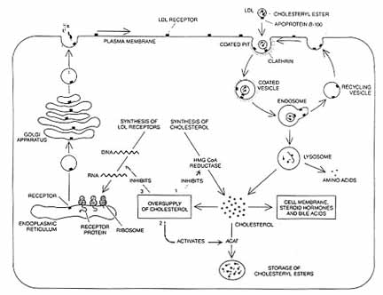
Hypercholesterolemia
Caused from a defect in the gene for low density lipoprotein (LDL) receptors
LDL is a protein-lipid complex.

Slide 8
Familial hypercholesterolemia (FH)
There are several classes of mutants in FH. The classes of mutations
are correlated with the region of the gene mutated. The receptor
protein has five domains, four of which correspond to the 4 classes of
mutants that have been found. Alu repeats found in several introns as
well as an Alu-like sequence in exon 13 are the cause of deletions.
1- Class 1 mutations are those that result in the deficiency of the receptor due to lack of transcription or translation.
2- Class 2 mutations result in the improper folding of the protein with the consequent trapping of the receptor in the endoplasmic reticulum (ER).
3- Class 3 mutations result in improper binding of LDL to the LDL receptor protein.
4- Class 4 mutations result in internalization defects due to improper clustering of the receptors in the coated pits.

Slide 9
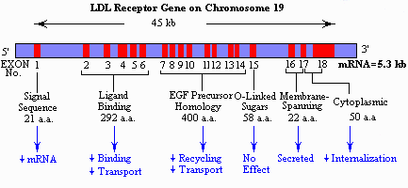

Slide 10
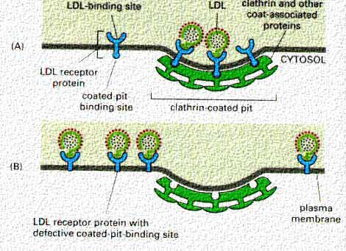

Slide 11
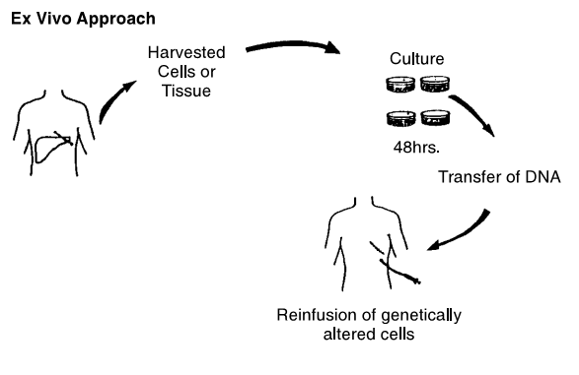
Basic Methods of Gene delivery
An introduction to molecular medicine and gene therapy, copyright 2001

Slide 12
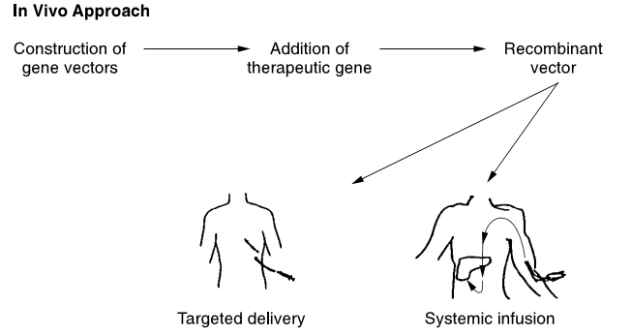
Basic Methods of Gene delivery
An introduction to molecular medicine and gene therapy, copyright 2001

Slide 13
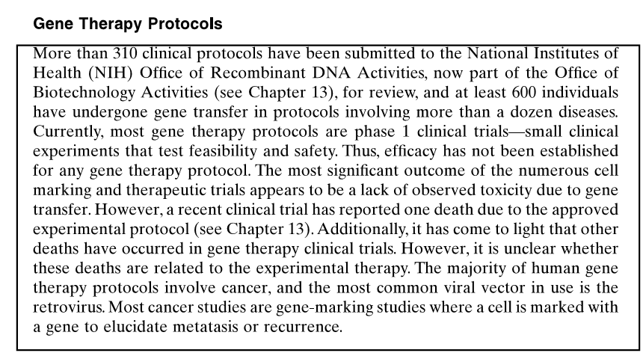
An introduction to molecular medicine and gene therapy, copyright 2001

Slide 14
Cancer (Factors involved in the change in perception as cancer is genetic disorder)

Slide 15
Cancer
Cancer is a genetic disease
The generation of neoplasia, abnormal proliferation, is a multistage process
Genes involved
Oncogenes
Tumor supprssor genes
DNA repair genes
Proposed indirect Therapies
Gene transfer of cytokines or other immune mediators to augment host immune response
The genetic modification of neoplastic cells to promote immunogenecity
The treatment of localized cancers with genes encloding viral or bacterial enzymes that convert prodrug into toxic metabolits
Transfer of gene that provide enhanced resistance to conventional chemotherapy

Slide 16
An introduction to molecular medicine and gene therapy, copyright 2001

